Slide 1
The Advance Directive Ontology (ADO)
A computable representation of end-of-life care preferences in advanced heart failure
Patrick Walsh • Darren Chan
CS270 • Stanford University
Clinical
scenario
OWL 2
ontology
Actionable
output
Notes:
PW: “I'm Patrick Walsh, this is Darren Chan. Our project is ADO — the Advance Directive Ontology. In one sentence: advance directives tell us what patients want at the end of life, but those documents are nearly useless when a clinician has to act on them at 2 a.m. We built a system that makes those preferences computable — and, critically, honest about what it doesn't know. ADO is decision support, not a legal directive."
**Transition:** "The problem is cascading information loss."

Slide 2
CLINICAL PROBLEM
The workflow has documents, orders, and gaps
End-of-life preferences often move through three different instruments. The loss happens in the middle: conditional patient wishes become coarse checkboxes or bedside orders.
1. Advance Directive
- Captures goals, values, and conditional wishes for future health states
- Broad, values-based, often conditional
2. POLST
- Medical orders for common scenarios based on current medical condition
- Scenario-limited, condition-specific
3. Code-Status Order
- Immediate orders acted on in an emergency: full code, DNR, DNI, Do Not Escalate
- Coarse, binary, context-poor
TRANSLATION
LOSS
TRANSLATION
LOSS
Example wish lost in translation
“I would accept a ventilator temporarily if the cause is reversible, but never indefinitely.”
A checkbox can record “ventilator: yes/no,” but not the conditional structure.
Advance Directive Ontology (ADO) | BMDS 210 / CS 270
2
Notes:
PW: "A patient's advance directive captures nuanced, conditional wishes: 'CPR only if there's a reversible cause.' That becomes a POLST — portable medical orders. That becomes a bedside code-status box: full code or DNR. At every translation, information vanishes. A patient's 'ventilator for a few days if reversible, but never indefinitely' collapses into one checkbox or disappears entirely. The deeper problem: these instruments are *low-resolution* and *disease-blind*. Generic templates don't mention ICDs, LVADs, or inotropes — yet 200,000 HF patients have devices. Heart failure is where this gap becomes dangerous."
**Transition:** "So we asked: what's the smallest structure that preserves patient logic?"

Slide 3
APPROACH
Core idea: turn patient language into computable preference objects
ADO preserves the original text, but gives a reasoner the structured facts it needs to decide whether a preference actually applies.
Intervention
vasopressor withdrawal
PreferenceStatement
“Do not continue vasopressors
if there is no improvement after 72 hours.”
ActivationCondition
no improvement; 72h
Strength
strong / conditional
Why preserve original language?
Negated?
no
It lets the system be auditable and lets clinicians see the patient’s words behind the inference.
OriginalText
verbatim quote
Advance Directive Ontology (ADO) | BMDS 210 / CS 270
4
Notes:
PW: "Everything in ADO is built from one core object — the PreferenceStatement. It has five parts: the specific **intervention** (CPR, Indefinite Ventilation, etc.); the **activation conditions** (what circumstances it applies to: NYHA class, clinical condition, reversible cause); the **strength** (Absolute vs. Weak); a **negated flag** (refuse vs. want); and the patient's **verbatim words**. That single record holds the patient's actual logic — not collapsed into a yes/no box. Later, when the reasoner meets a clinical scenario, it checks those conditions one by one instead of guessing."
**Transition (Darren):** "That's the unit. We built an ontology on top of it."

Slide 4
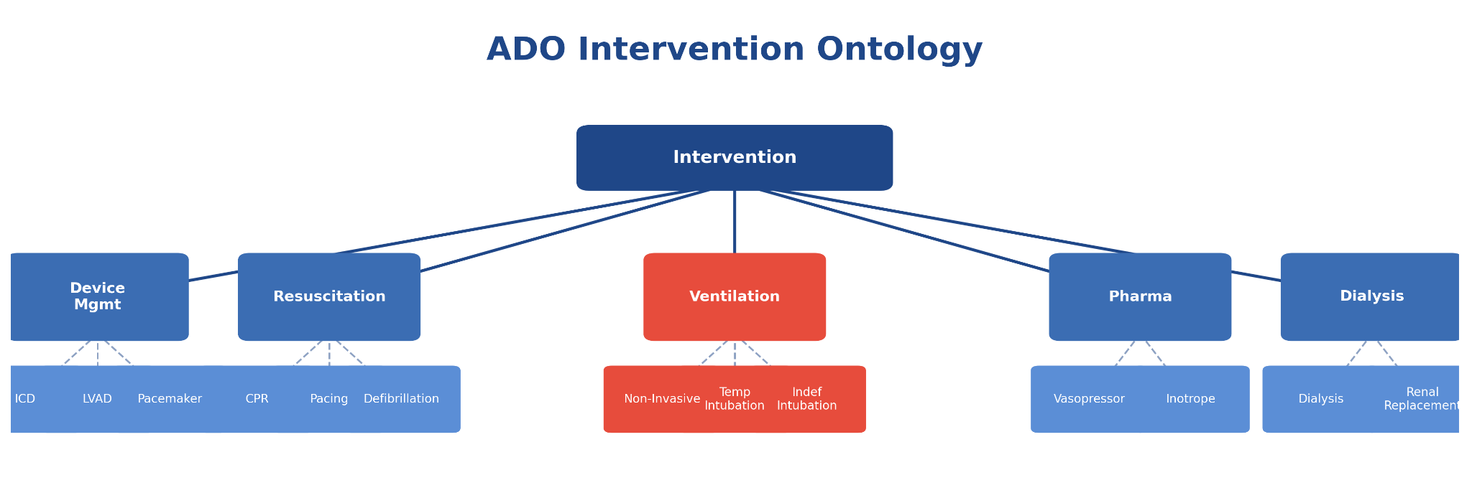
Notes:
Darren: "The ontology has 67 classes, 22 properties, and 21 specific interventions. Five decision points: Device management (ICD, LVAD, pacemaker deactivation), Resuscitation (CPR, pacing, defibrillation), Ventilation, Pharmacologic (vasopressors, inotropes), and Dialysis. The key design: Ventilation splits into Intubation → Temporary vs. Indefinite. A patient says 'few days if reversible' — that's Temporary. 'Never indefinitely' — that's Indefinite. A checkbox collapses both. We keep them apart. This is OWL 2 DL, consistency-checked with HermiT, not a lookup table."
**Transition:** "How does the system work?"

Slide 5
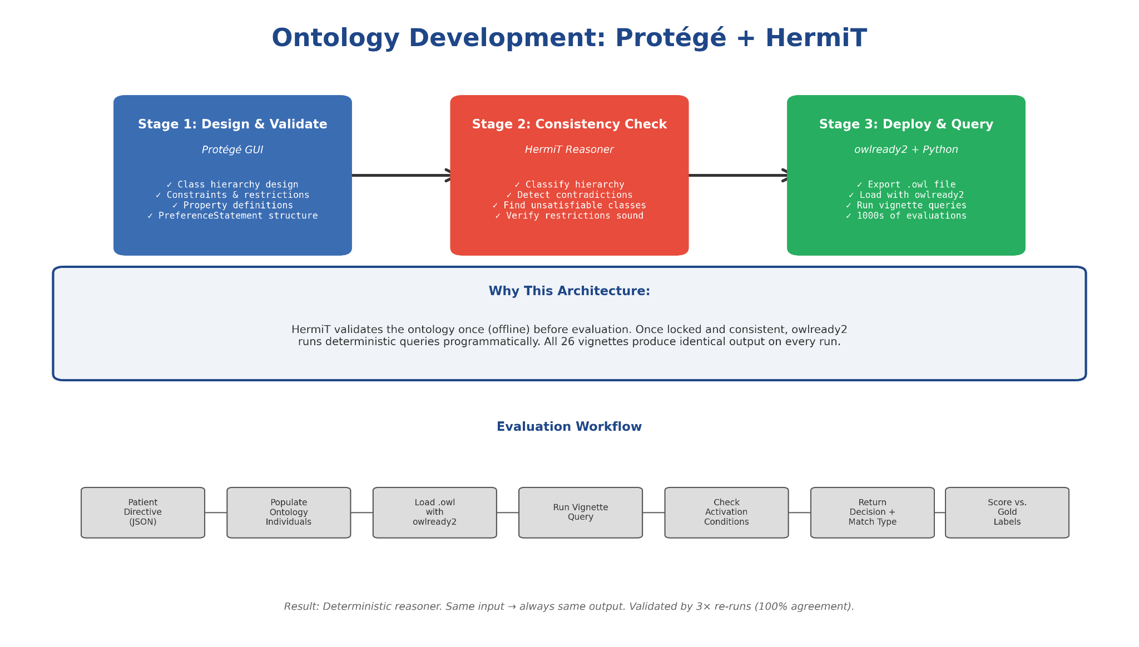
Notes:
"DC: We built the ontology in Protégé, Stanford's OWL editor. HermiT validates it offline — classifies the hierarchy, detects contradictions, checks that every constraint is satisfiable. Once locked and sound, we export it as standard W3C OWL 2 DL and load it with owlready2 for programmatic querying. The reasoner is deterministic: every vignette produces the same answer on every run. We validated this by re-running our 16 vignettes three times — 100% agreement each time."
**Transition:** "Now here's what happens when you query."

Slide 6
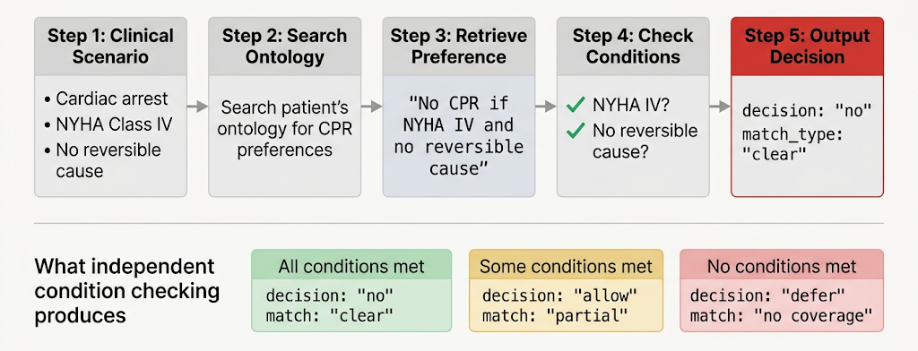
Notes:
DC: "A vignette is a clinical snapshot: cardiac arrest, NYHA IV, no reversible cause. We search the patient's ontology for matching preferences — here, a CPR-negated preference. Then we check its activation conditions one by one: NYHA IV met? Yes. No reversible cause required? Yes. Time bound? None. Conditions satisfied? All yes → decision: 'no', match type: 'clear'. Same preference, different scenario: patient is NYHA III and cause IS reversible. Conditions not all met → decision still 'no' [because preference is negated, unmet conditions mean CPR is allowed], but match type: 'partial' — defer to surrogate. The key: conditions are independent. Some met means partial, not met means no coverage, ambiguous language means vague. The reasoner can be honest."
**Transition:** "That's one patient at scale. But one isn't enough."

Slide 7
OUTPUT SEMANTICS
The reasoner is designed to be honest, not overconfident
Instead of forcing a binary answer, ADO returns one of four outputs that tell a clinician how much the directive actually says.
Clear match
No coverage
conditions met; unambiguous
directive is silent for this scenario
Clinical
scenario
Partial match
Vague match
some conditions uncertain/unmet; defer
imprecise language surfaced
This is the safety feature: uncertainty becomes visible rather than hidden behind a confident answer.
Advance Directive Ontology (ADO) | BMDS 210 / CS 270
6
Notes:
DC:"Given a patient's encoded preferences and a clinical scenario, the reasoner returns one of four outputs. *Clear*: the conditions are met and the answer is unambiguous. *Partial*: some conditions are met but others aren't, so we defer to the surrogate rather than guess. *No coverage*: the directive simply doesn't address this situation — escalate, don't presume. And *Vague*: when the language is irreducibly fuzzy, like 'no heroic measures,' we surface the patient's own words instead of forcing a yes or no. In this setting, a system that *can't* say 'I don't know' isn't a convenience problem — it's a safety failure. Those three honest non-answers are the point."

Slide 8
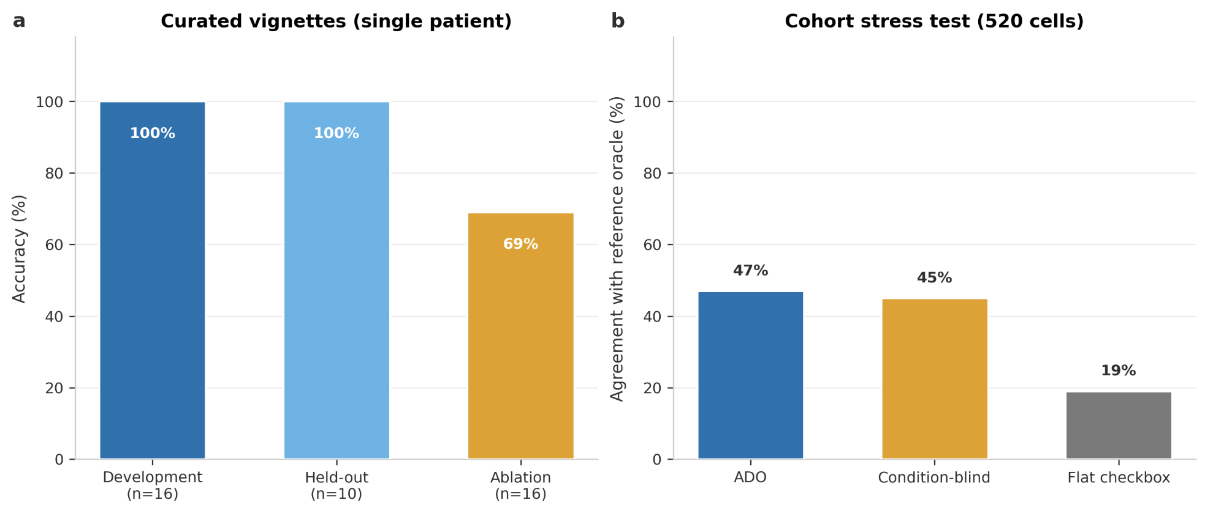
Notes:
PW: "Layer one — the spec test: one patient, 16 development vignettes, all correct. 10 held-out vignettes, all correct — 26 out of 26. When we remove activation conditions, accuracy drops to 69%, proving the conditional logic does real work. But this is *one carefully-encoded patient*. It's a proof of correctness, not generalization.
Layer two — the honest layer: 20 realistically-encoded patient profiles, 12 clinical scenarios, 520 decision cells total. ADO agrees with a simplified reference oracle on about 47% of cells. Much lower. And that's the point — real directive encoding is *hard*. Ambiguity, gaps, clinician variation. But here's what matters: in 421 of those 520 cells — 81% — the correct answer was genuinely partial, vague, or no-coverage. A checkbox forces yes or no anyway. ADO preserves the actual uncertainty. That's the win: spec test proves correctness; stress test proves honesty."
**Transition:** "Here's what conditional reasoning concretely buys you."
"Layer one — the spec test: one patient, 16 development vignettes, all correct. 10 held-out vignettes, all correct — 26 out of 26. When we remove activation conditions, accuracy drops to 69%, proving the conditional logic does real work. But this is *one carefully-encoded patient*. It's a proof of correctness, not generalization.
Layer two — the honest layer: 20 realistically-encoded patient profiles, 12 clinical scenarios, 520 decision cells total. ADO agrees with a simplified reference oracle on about 47% of cells. Much lower. And that's the point — real directive encoding is *hard*. Ambiguity, gaps, clinician variation. But here's what matters: in 421 of those 520 cells — 81% — the correct answer was genuinely partial, vague, or no-coverage. A checkbox forces yes or no anyway. ADO preserves the actual uncertainty. That's the win: spec test proves correctness; stress test proves honesty."
**Transition:** "Here's what conditional reasoning concretely buys you."
**Speaker notes:**
"[Point to the left panel: Layer A, the vignette spec test.] This is layer one — controlled, tidy, one encoded patient. 16 development vignettes, all correct. 10 held-out vignettes, all correct — that's 26 out of 26. And when we strip out activation conditions (treat every preference as unconditional) it drops to 11 out of 16, or 69%. That tells us the conditional logic is doing real work. But here's the crucial caveat: this is *one patient*, carefully encoded by the team. It's a specification test — proof that the logic is consistent — not proof that it generalizes.
[Point to the right panel: Layer B, the cohort stress test.] This is the honest layer. We took 20 messy, realistically-encoded patient profiles — varying in quality, some contradictory, some minimal — and ran them through 12 clinical scenarios. That's 520 decision cells. ADO agreed with an independent, simplified reference oracle on about 47% of those cells. That's *much* lower than the vignettes, and that's exactly the point. It's not a failure — it's where the rubber meets the road. Real-world preference encoding is hard; there's ambiguity in the chart, gaps in what was documented, clinicians coding things differently. That 47% reflects that reality, not a deployment-ready error rate.
But here's what matters most. [Point to the lower annotation.] In 421 of those 520 cells — that's 81% — the correct answer was partial, vague, or no-coverage. In other words, there was genuine uncertainty or the directive didn't address the scenario. If you gave a flat checkbox to a clinician in those 421 cases, they'd be forced to pick yes or no anyway, guessing. ADO says 'defer to the surrogate' or 'the directive is silent.' That epistemic honesty is the entire architectural win."
**Transition:** "Let me show you concretely what the conditional layer buys."

Slide 9
CLINICAL INTEGRATION
Best workflow fit: pre-populating an ACP note
Expert review reframed ADO as documentation support rather than a legal directive. This preserves its value while avoiding the wrong legal claim.
Existing AD
verbatim wishes
ADO
structured preferences
Epic ACP note
pre-populated fields
Provider conversation
clarify or override
Final record
ACP + POLST/code status
Source-of-truth priority
ACP conversation can clarify or supersede AD preferences. But when a decision is not revisited, the structured AD remains the best available record of the patient’s wishes.
Advance Directive Ontology (ADO) | BMDS 210 / CS 270
11
Notes:
PW: "The directive goes through ADO. ADO extracts and structures the preferences into ontology individuals. That feeds into Epic to pre-populate an advance-care-planning note with structured fields. The clinician and family then have a summary to start the conversation — they can clarify, override, or update. The final record is what a human signs. ADO is documentation support, not a decision-maker. It informs; humans decide."
**Transition:** "With that, a few honest limits and what's next."

Slide 10
SYSTEM IMPLEMENTATION
End-to-end architecture
LLMs are used only at the boundary. The ontology remains the auditable source of truth, and the deterministic reasoner produces the clinical output.
Structured form
or free text
Closed-world
LLM extraction
Validated JSON
preferences
OWL ontology
+ individuals
Scenario-based
reasoner
ACP note
POLST/code status
Closed-world rule
Reasoner responsibility
Extract only what the patient explicitly states; do not map out-of-scope content to the nearest covered class.
Match intervention + activation conditions + negation + strength against the clinical scenario.
Advance Directive Ontology (ADO) | BMDS 210 / CS 270
7
Notes:
DC: "The architecture has one organizing principle: language models are used *only at the boundaries*. A free-text directive goes through an LLM that extracts structured preferences — and we constrain it to *closed-world* extraction, meaning it encodes only what the patient actually said and never infers. Those structured preferences populate the ontology, which is the auditable source of truth, and the reasoner produces the decision. Why this split? Because a pure language model in end-of-life care is dangerous — it's non-deterministic and confidently wrong. An auditable reasoner can do the one thing the LLM won't: honestly report when the directive is silent."
**Transition:** "So — does it actually work? We tested it six ways, including a 520-cell cohort stress test." *(Darren continues into Act III.)*

Slide 11
LIMITS + PRIORITIES
Expert Qualitative Review - Dr. David Magnus
The critique did not eliminate the system’s value; it moved ADO to the right place in the clinical workflow and exposed the next modeling gaps.
Positioning
Decision-support aid, not a signed legal directive
Dimensionality
Current model covers what intervention; next model must cover who decides
Coverage gaps
Artificial hydration/nutrition; antibiotics; comfort-care decisions
Temporal limits
OWL lacks native temporal reasoning; ADO uses numeric time bounds
Validation limits
Team-authored gold standards; real-EHR validation remains future work
Design principle: use the reasoner to surface uncertainty, not to replace clinicians or surrogates
Advance Directive Ontology (ADO) | BMDS 210 / CS 270
12
Notes:
PW: "EOL care is incredibly complex and
Positioning: ADO has no legal force.
Dimensionality: Magnus also identified the deepest gap: the model is one-dimensional. Real preferences have a second axis — not just *what* you want, but *who* decides — and many patients explicitly want their family to be able to override them. So our priorities are: add that surrogate-override axis
Coverage gaps: add artificial nutrition and the POLST time-limited-trial concept, and validate against real EHR code-status data."
Temporal Limits: OWL lacks native temporal reasoning; ADO uses numeric time bounds
Validation limits: Our cohort 'oracle' is a simplified reference, not hand-adjudicated clinical gold, so that 47% is a stress-test signal. Next, we will validate against real EHR code-status data. We have shown developmental validation; next is clinical validation."
**Transition:** "To bring it together —"

Slide 12
Takeaways
1
ADO makes conditional, graded, negatable EOL preferences computable.
2
The safest outputs include honest non-answers: no coverage, partial, and vague.
3
LLMs are useful for extraction, but the auditable ontology/reasoner should own inference.
4
The near-term product is ACP documentation support, not a legal directive.
Next steps: surrogate/override modeling • artificial nutrition/hydration • time-limited trials • real-EHR validation
Notes:
PW:”Four takeaways.
One: ADO makes conditional, graded, negatable end-of-life preferences computable.
Two: it produces honest outputs — including honest non-answers: 'partial', 'no coverage', 'vague'.
Three: the architecture is ontology *with* LLMs at the boundaries — not ontology versus LLM. The code, ontology, and all evaluation are on GitHub."
Four: The near-term product is ACP documentation support, not a legal directive.

Slide 13
References
1. Respecting Choices & National POLST Paradigm. POLST: Physician Orders for Life-Sustaining Treatment. https://polst.org
2. Jaarsma, T., et al. (2018). Advanced heart failure: a position statement of the Heart Failure Association of the ESC. European Journal of Heart Failure, 20(12), 1505–1535.
3. Billings, J. A. (2011). The need for safeguards in advance care planning. Journal of Palliative Medicine, 14(12), 1389–1395.
4. W3C OWL Working Group. (2012). OWL 2 Web Ontology Language: Profiles. https://www.w3.org/TR/owl2-profiles/
5. Musen, M. A. (2015). The Protégé project: a look back and a look forward. AI Matters, 1(4), 1–4.
6. Tsatsaronis, G., et al. (2015). An overview of the BIOASQ large-scale biomedical semantic indexing and question answering competition. BMC Bioinformatics, 16(1), 138.
7. Ong, L. M., et al. (2023). Large language models in medicine: Opportunities for clinical applications. JAMA Network Open, 6(8), e2333856.
8. Shortliffe, E. H., & Buchanan, B. G. (1975). A model of inexact reasoning in medicine. Mathematical Biosciences, 23(3), 351–379.
9. Bossuyt, P. M., et al. (2015). STARD 2015: an updated statement for reporting diagnostic accuracy studies. BMJ, 351, h5527.
10. Linden, M. (2026). Expert review: ADO ontology completeness and clinical integration. Stanford University, May 27, 2026. [Internal review]
11. Lampert, R., et al. (2010). HRS expert consensus statement on the management of cardiovascular implantable electronic devices in patients nearing end of life or requesting withdrawal of therapy. Circulation, 122(16), 1666–1675.
Notes:
PW: "EOL care is incredibly complex and
Positioning: ADO has no legal force.
Dimensionality: Magnus also identified the deepest gap: the model is one-dimensional. Real preferences have a second axis — not just *what* you want, but *who* decides — and many patients explicitly want their family to be able to override them. So our priorities are: add that surrogate-override axis
Coverage gaps: add artificial nutrition and the POLST time-limited-trial concept, and validate against real EHR code-status data."
Temporal Limits: OWL lacks native temporal reasoning; ADO uses numeric time bounds
Validation limits: Our cohort 'oracle' is a simplified reference, not hand-adjudicated clinical gold, so that 47% is a stress-test signal. Next, we will validate against real EHR code-status data. We have shown developmental validation; next is clinical validation."
**Transition:** "To bring it together —"

Slide 14

GitHub Repo
Notes:
PW: "EOL care is incredibly complex and
Positioning: ADO has no legal force.
Dimensionality: Magnus also identified the deepest gap: the model is one-dimensional. Real preferences have a second axis — not just *what* you want, but *who* decides — and many patients explicitly want their family to be able to override them. So our priorities are: add that surrogate-override axis
Coverage gaps: add artificial nutrition and the POLST time-limited-trial concept, and validate against real EHR code-status data."
Temporal Limits: OWL lacks native temporal reasoning; ADO uses numeric time bounds
Validation limits: Our cohort 'oracle' is a simplified reference, not hand-adjudicated clinical gold, so that 47% is a stress-test signal. Next, we will validate against real EHR code-status data. We have shown developmental validation; next is clinical validation."
**Transition:** "To bring it together —"

Slide 15
QUANTITATIVE EVALUATION
Results
16/16
16/16
0.97
35/36
κ=1.00
vignette decision accuracy
match-type accuracy
LLM extraction F1
code/POLST field agreement
code status + POLST A
Ontology and Reasoner ablation
Full reasoner
100%
Ignoring activation conditions produced false-confident errors on the four conditional cases.
Condition-blind
75%
Dropping the ontology and reasoner entirely resulted in dropped performance on ambiguous cases.
E2E LLM Chatbot-style
62%
E2E Full context LLM API call
75%
Key finding: conditional logic prevents dangerous over-reading
Advance Directive Ontology (ADO) | BMDS 210 / CS 270
9
Notes:
DC: "Layer one is the controlled specification test: on a single, carefully encoded patient, the reasoner scored 16 out of 16 on development vignettes and 10 out of 10 on held-out vignettes. That tells us the logic is correct — but it's one patient, so it's a spec test, not generalization. The honest layer is layer two: the cohort stress test. Across 520 decision cells from 20 messy, realistically-encoded profiles, ADO agreed with an independent simplified reference oracle about 47% of the time. That number is *much* lower than the vignettes, and that's the point — it reflects how hard messy real-world encoding actually is, and it's nowhere near a deployment-ready error rate. But here's the comparison that matters: in 421 of those 520 cells — 81% — the correct answer was partial, vague, or no-coverage, where a flat checkbox is *forced* to give a definitive yes or no. ADO preserves the honesty a checkbox structurally cannot."
**Transition:** "Let me show you concretely what the conditional layer buys."

Slide 16
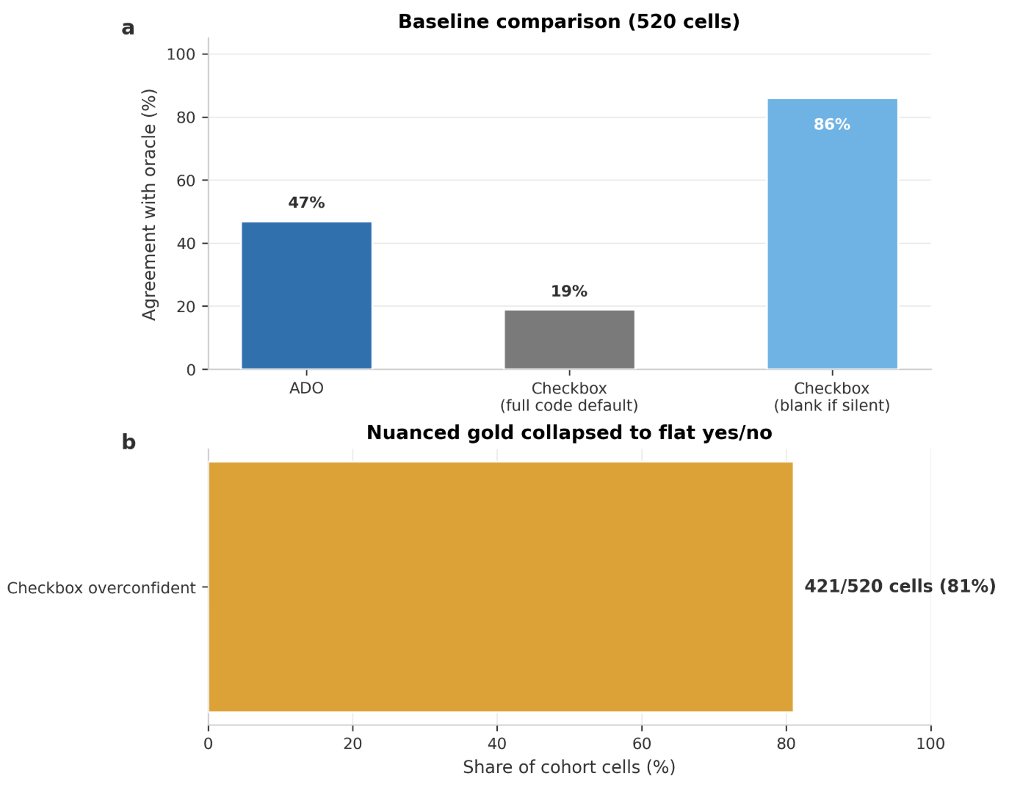
Notes:
PW: **Notes on the cohort design:** "Twenty patient profiles tagged by messiness level — clean, minimal, contradictory, incomplete — crossed with 12 clinical scenarios. That's 520 decision cells total. ADO agrees with a simplified independent oracle on about 47% of those cells."
**Notes on the baseline comparison (the key figure):** "The right panel compares three approaches on these 520 cells. First, ADO — 47% agreement with the oracle, meaning partial, vague, and no-coverage answers in the remaining 53%. Second, a checkbox with *full-code default* — if the directive is silent, presume full resuscitation. That approach scores artificially high on agreement because it matches the oracle's 'no coverage = defer' on only some cells, but it's dangerously overconfident. Third, a checkbox that's *blank if silent* — it leaves the cell unspecified. That's lower agreement because it doesn't commit to an answer. The real win for ADO: in 421 of the 520 cells — 81% — the correct answer was genuinely partial, vague, or no-coverage. A checkbox forces yes or no anyway; ADO says 'I don't know,' which is exactly right. Performance also stratifies by messiness: clean profiles score highest, contradictory and minimal encodings lower — that's honest sensitivity to data quality, not a bug."

Slide 17
EXAMPLE DECISION LOGIC
What conditional reasoning changes
The same directive can map to different bedside outputs depending on the scenario. ADO keeps that conditionality explicit.
Directive preference
“No CPR if NYHA IV and no reversible cause.”
Scenario A
NYHA IV + no reversible cause
Scenario B
NYHA III + reversible cause
ADO output
DNR / clear match
ADO output
Full code / partial
A flat checkbox cannot carry this “if/then” structure; it must either over-apply or discard it.
Advance Directive Ontology (ADO) | BMDS 210 / CS 270
10
Notes:
DC: "Same preference, two scenarios. Scenario A: NYHA IV, no reversible cause — conditions met, answer is unambiguous: DNR. Scenario B: NYHA III, reversible cause — conditions not met, answer is 'allow CPR,' but partial because the directive only *conditionally* applies. A flat checkbox cannot carry 'if/then.' It applies everywhere or nowhere. ADO keeps the conditionality explicit — same directive, two scenarios, two correct answers. That's what the 69% ablation told us."
**Transition (to Patrick):** "So where does this fit in real care?"

